Slide 1

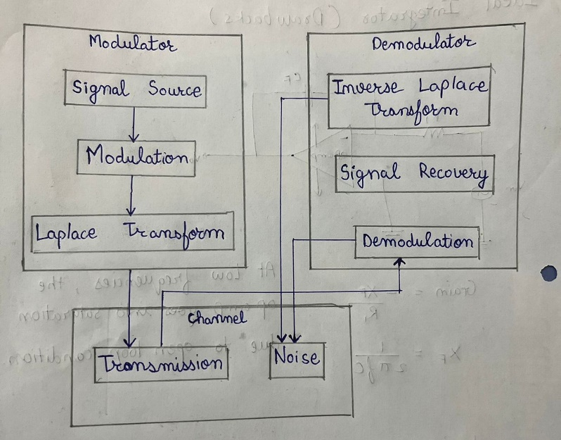
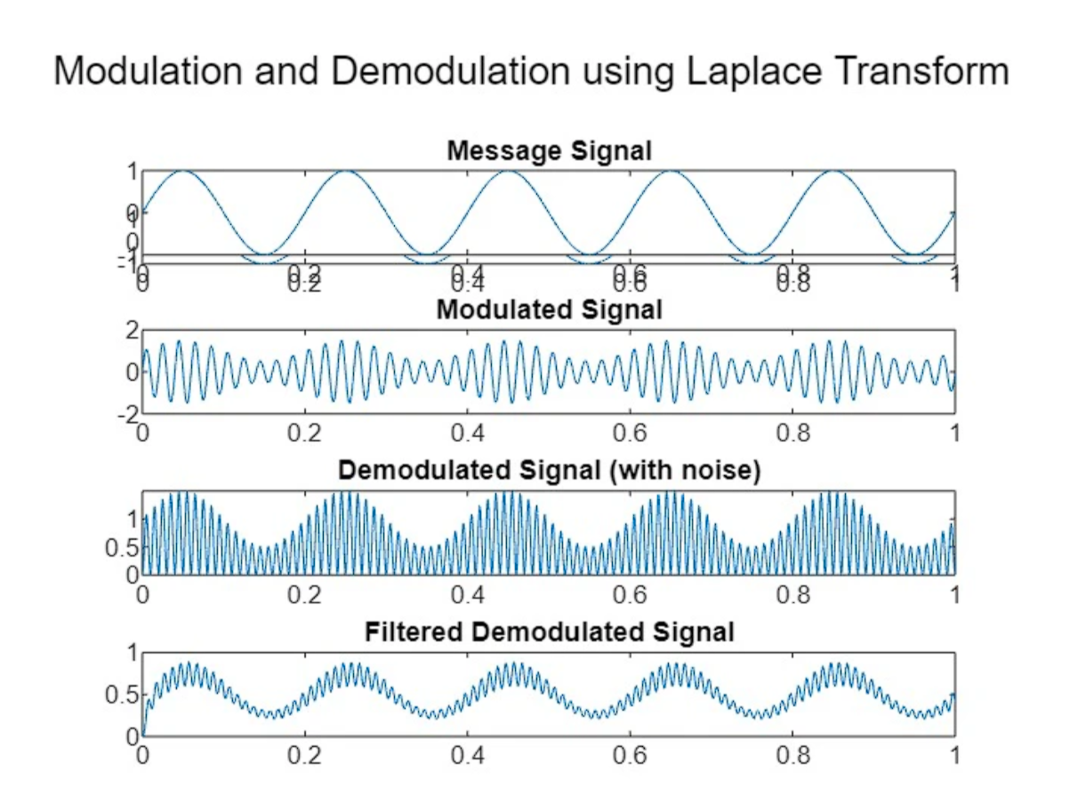
School of E&TC Engineering
Modulation and Demodulation using Laplace Transform
Abstract of Idea
Modulation and demodulation are vital processes in communication systems, facilitating signal transmission and reception. In modulation, the combination of information and carrier signals is examined in the frequency domain, revealing insights into signal interactions and system parameters. Similarly, Laplace Transform is applied to demodulation, shedding light on signal recovery and the impact of noise. This abstract underscores the symbiosis between communication theory and mathematical analysis, emphasizing Laplace Transform's role in modeling and optimizing modulation and demodulation systems. It encapsulates the essence of using Laplace Transform to unravel the complexities of signal processing for effective communication.
Methodology
Define Parameters: Identify key system components, including information and carrier signals.
Mathematical Modeling: Express modulation and demodulation processes through equations.
Laplace Transform: Apply Laplace Transform to analyze the system in the frequency domain.
Frequency Analysis: Gain insights into signal behavior and frequency components.
Demodulation Modeling: Extend modeling to include signal extraction at the receiver.
Laplace Transform for Demodulation: Analyze demodulation in the frequency domain.
Optimization: Adjust parameters based on insights to optimize system performance.
Validation: Confirm theoretical findings through simulation or experimentation.
Block Diagram & Results
References
Wave, Modulated, and A. M. Wave. "Modulation and demodulation.".
Vidyarani K R. "Implementation of Analog Modulation Techniques using TMS320C6748 and LabVIEW." IOSR Journal of Research & Method in Education (IOSR-JRME) 7.4 (2017): 46-50.
Patrick Marsch; Jyrki Penttinen, "Modulation and Demodulation," in The Telecommunications Handbook: Engineering Guidelines for Fixed, Mobile and Satellite Systems , Wiley, 2013, pp.261-280, doi: 10.1002/9781118678916.ch10.
Group No: 1
Group Members:
Vaibhav Pawankar (202201070124)
Ayush Fating (202201070127)
Kaustubh Mahajan (202201070128)
Division & Batch: B / B3

